Slide 1
Quantum Optimization
A Tale of Low-Depth Quantum Algorithms

Slide 2
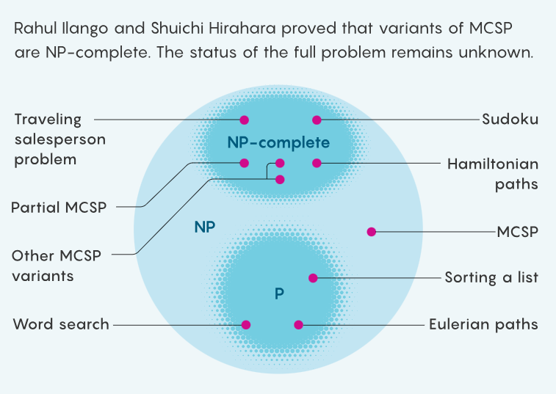
Time is everything

Slide 3
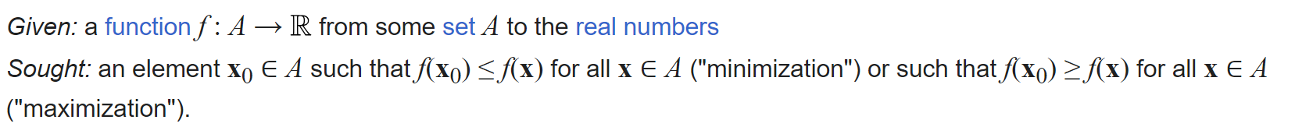
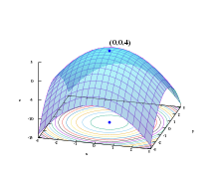
mathematical Optimization
The selection of a best element, with regard to some criterion, from some set of available alternatives

Slide 4
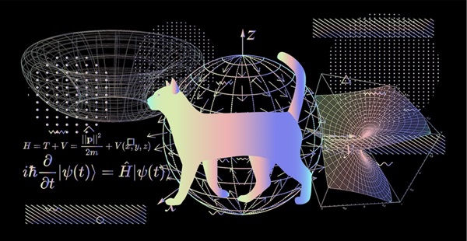
quantum supremacy
The goal of demonstrating that a programmable quantum computer can solve a problem that no classical compute

Slide 5
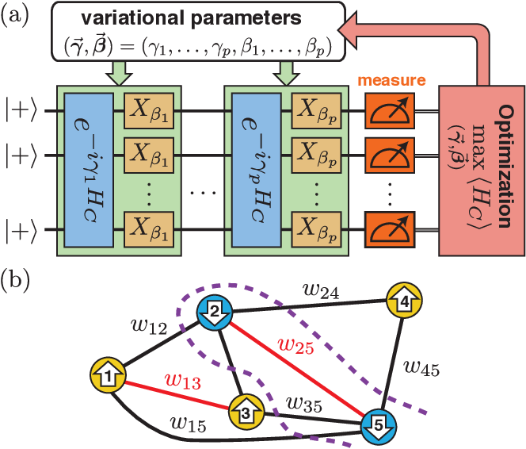
Quantum optimization algorithms
Quantum algorithms that are used to solve optimization problems

Slide 6

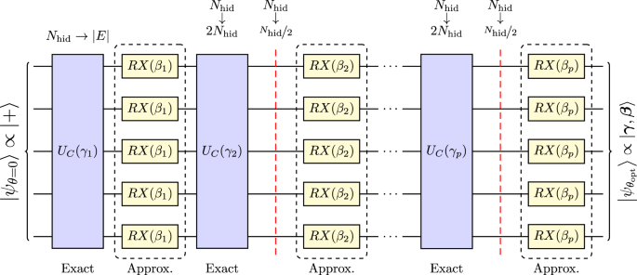
Iterative quantum algorithms
tackle a problem iteratively in an interactive fashion, with each iteration reducing the size or connectivity of the problem until the optimal solution is trivia
variational circuits – designed for noisy and imperfect quantum computers

Slide 7
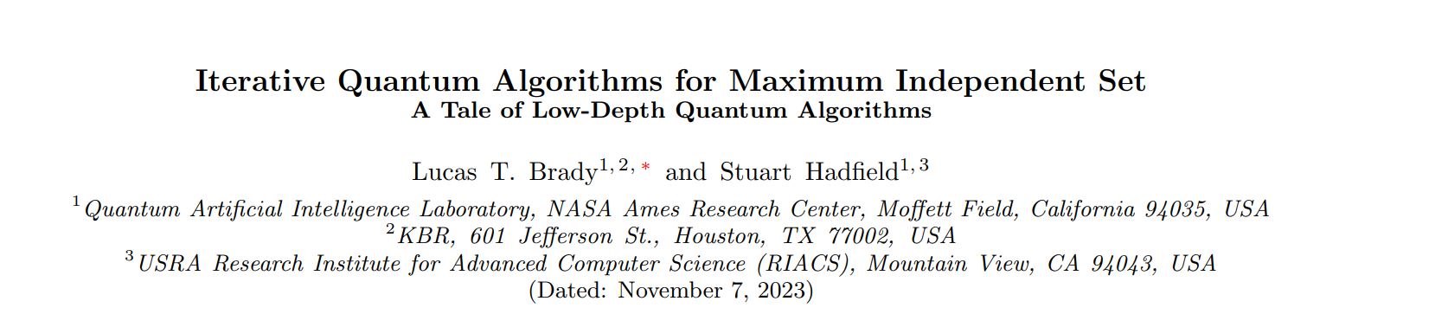
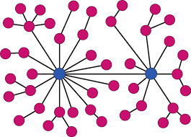

Slide 8
What is our Problem?

Slide 9
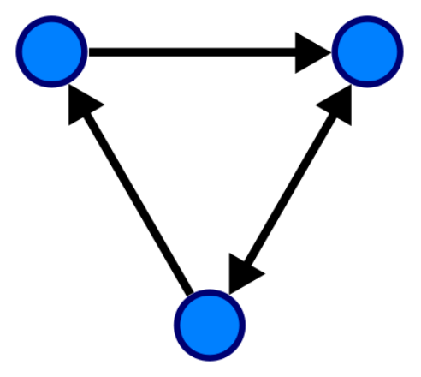
A Graph problem

Slide 10
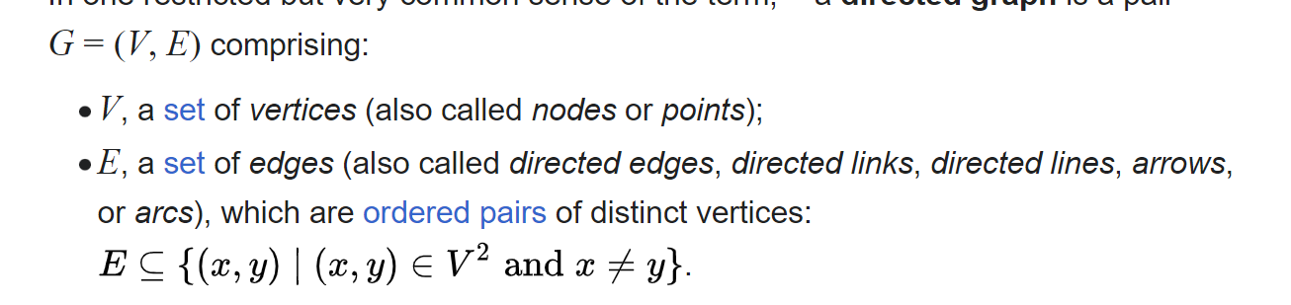
Graph

Slide 11
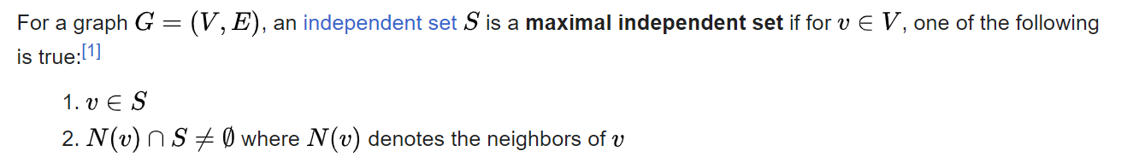
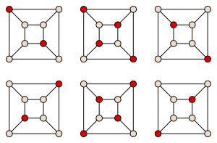
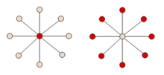

Max independent set problem
NP-HArd

Slide 12
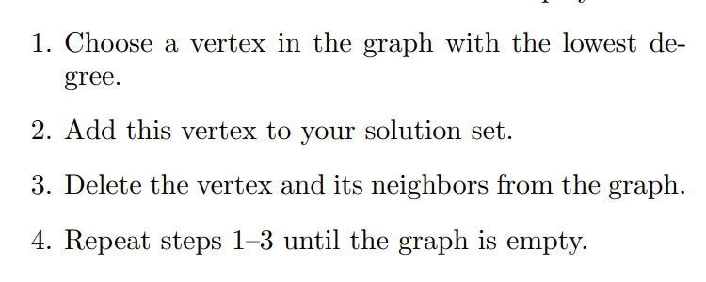
COMMENT: Max – an alternative algorithm that chooses the highst degree vertex
Classical greedy algorithm - min

Slide 13
Iterative quantum algorithms
A new class of hybrid approaches to quantum optimization

Slide 14
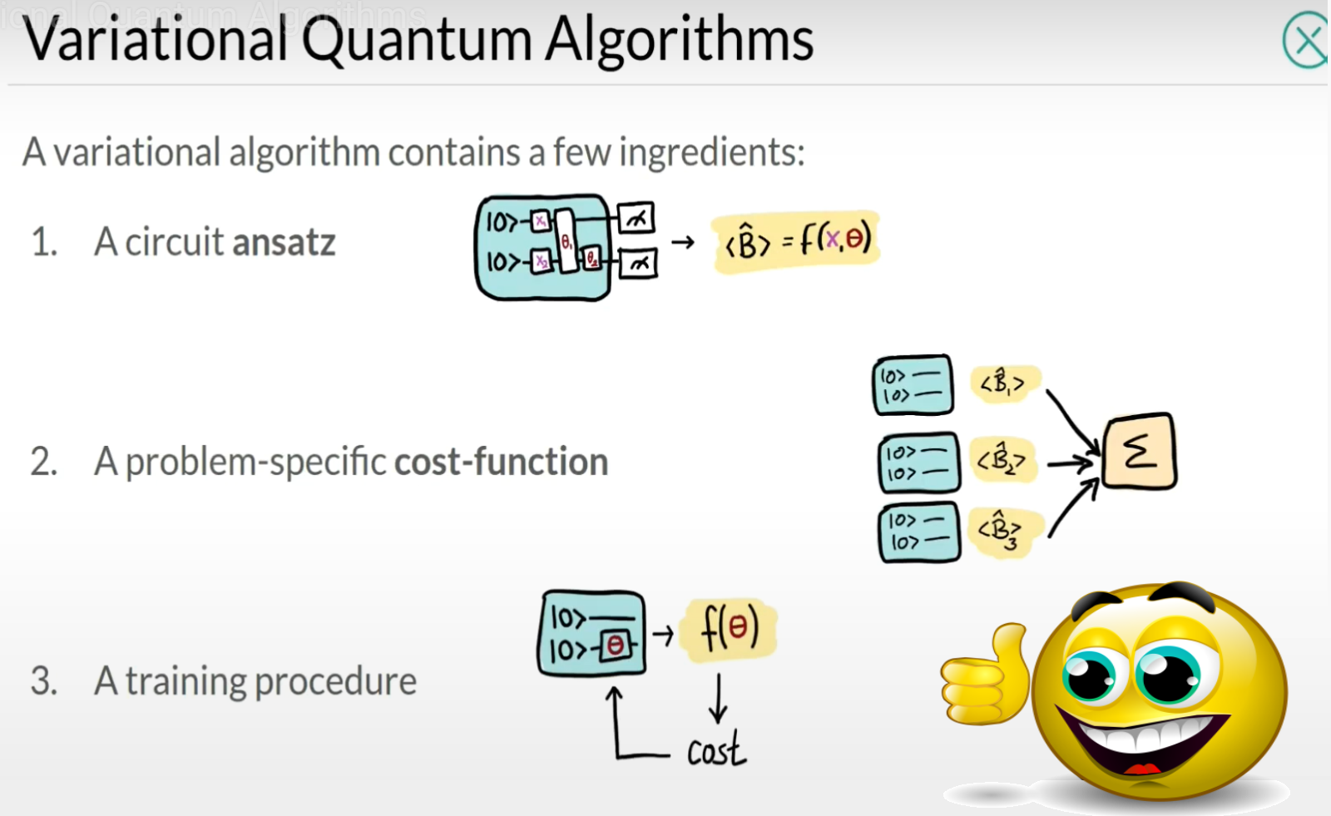

Slide 15
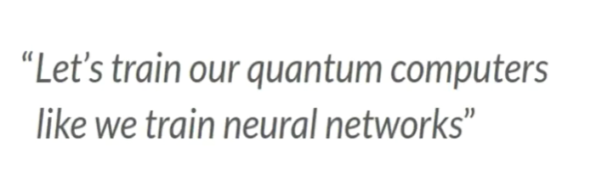
QAOA - Quantum approximate optimization algorithm
Low Depth Burst of Calculations
Result Analysis
Parameters Adjustment

Slide 16
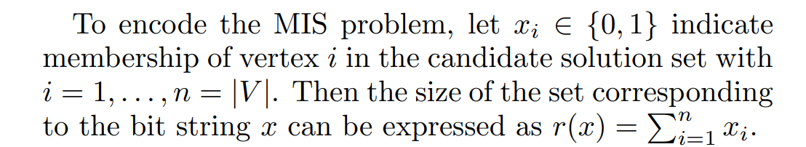


Reformulation A problem into a hamiltonian

Slide 17
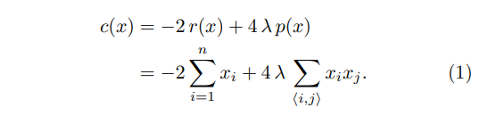
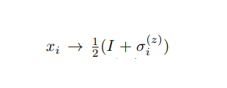
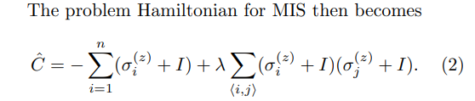
Reformulation A problem into a hamiltonian

Slide 18
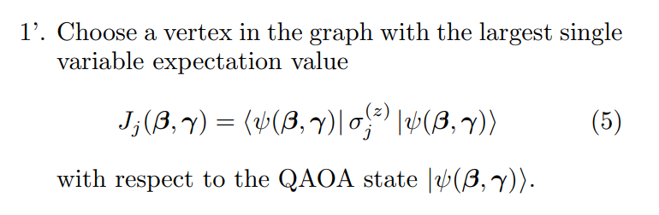
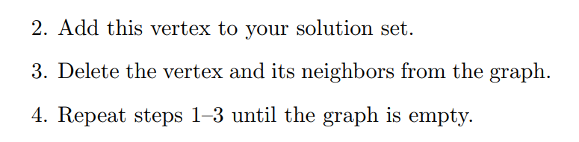
Enhanced QAOA

Slide 19
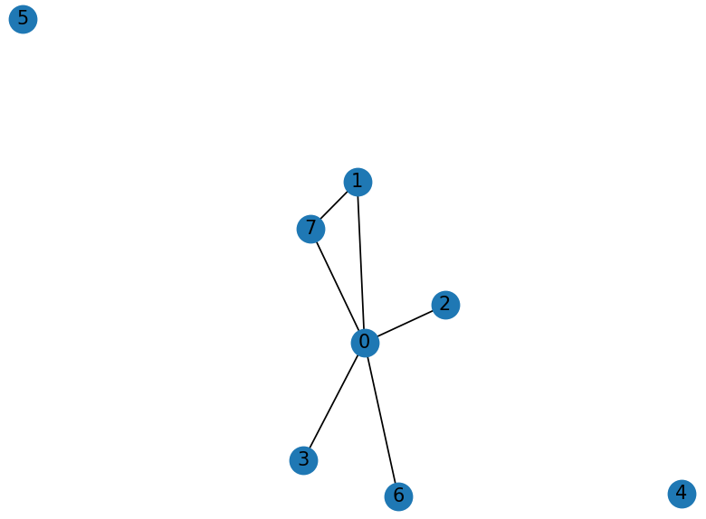

Slide 20
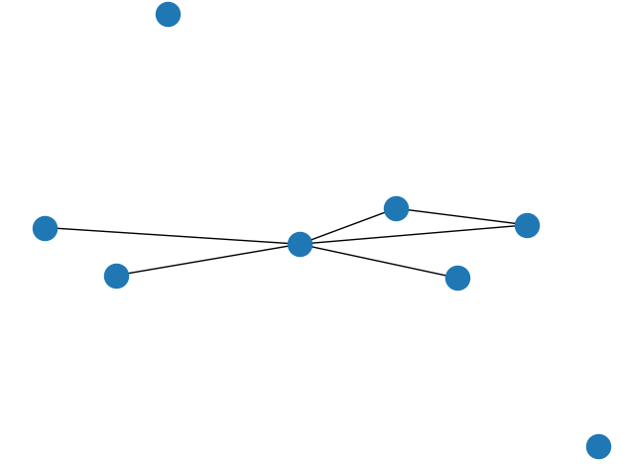
An input that result in an optimal

Slide 21
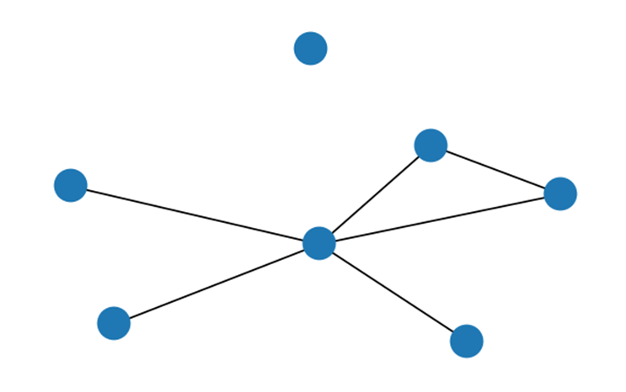
After one iteration

Slide 22
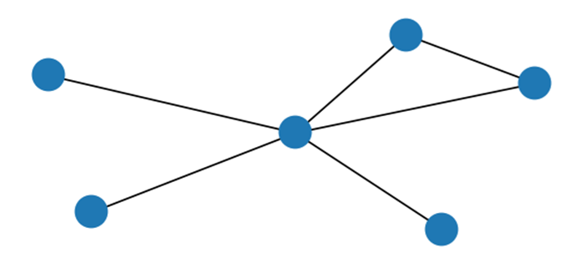
After two iterations

Slide 23
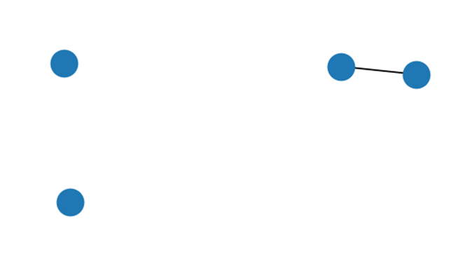
After three iterations

Slide 24
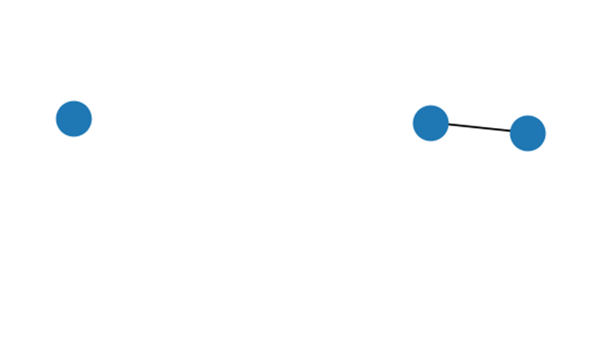
After four iterations

Slide 25
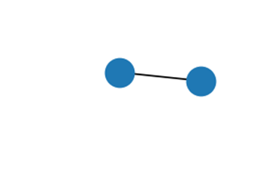
After five iteration

Slide 26
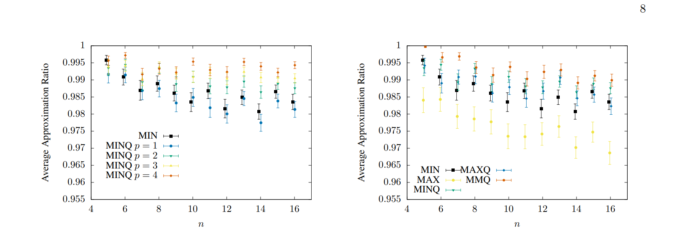

Results (fig 2. & fig3.)
Approximation Ratio - achieved set size divided by the true maximum independent set size
n – number of vértices in erdös-Rényi graphs with edge probability q = 1.2 ln(n)/n

Slide 27
Conclusiones
The work takes important steps towards extending iterative quantum algorithms to wider classes of optimization problems.
The iterative quantum approach for MIS also immediately yields approximation algorithms for the Maximum Clique and Minimum Vertex Cover problems via simple problem transformations

Slide 28
wherein lies the future
More work is needed toward better understanding the requirements for achieving bonafide quantum advantage.
An important future direction is to explore further classes problems in detail.
As quantum hardware continues to advance, the deployment of more sophisticated quantum circuits should empirically inform the design of even more effective iterative quantum algorithms and heuristics.

Slide 29
Resorces
Slide no. 2
https://www.google.com/url?sa=i&url=https%3A%2F%2Fwww.quantamagazine.org%2Fcomplexity-theorys-50-year-journey-to-the-limits-of-knowledge-20230817%2F&psig=AOvVaw0bIO1ATey4r9xk9mhuvfZS&ust=1701179962023000&source=images&cd=vfe&opi=89978449&ved=0CBQQjhxqFwoTCLiNvKyr5IIDFQAAAAAdAAAAABAE
Slide no. 3
https://en.wikipedia.org/wiki/Mathematical_optimization
Slide no, 4
https://thenextweb.com/news/relational-quantum-mechanics-carlo-rovelli-syndication
Slide no. 5
https://medium.com/@kazi.abdullah/unlocking-the-power-of-quantum-optimization-a-journey-through-the-qaoa-algorithm-by-abdullah-5366fd6a4f16
Slide no. 6
https://www.researchgate.net/figure/a-Graph-with-n-nodes-where-two-star-coupled-networks-are-connected-by-one-edge-through_fig2_247691180
Slide no. 7, 12, 16, 17, 18 ,15, 26 ,27, 28
2309.13110.pdf (arxiv.org)

Slide 30
Resorces
Slide no. 9, 10
https://en.wikipedia.org/wiki/Graph_(discrete_mathematics)
Slide no. 11
https://en.wikipedia.org/wiki/Maximal_independent_set#Finding_a_single_maximal_independent_set
Slide no. 6, 13
https://pixabay.com/de/illustrations/smile-smiley-cool-sonnenbrille-3175828/
Slide no. 14
https://www.youtube.com/watch?v=YtepXvx5zdI&ab_channel=Xanadu
http://pngimg.com/image/36052
Slide no. 15
https://www.nature.com/articles/s41534-021-00440-z

